Slide 1


Slide 2

How Azure, Windows 10 & Citrix solutions can create a
First Class user experience

Slide 3

Azure as a Platform
Services that creates value
A 1st class user experience
Notes:
We’ll discuss why you would want to use Azure (or tbh any public cloud) to host Citrix (or tbh any app/desktop virtualization solution).
After that we go higher up in the stack (not the Azure Stack – even though I have customers looking into Azure stack to host their App-virt solutions) and examine the challenges with PaaS and SaaS services offered from Azure with Citrix technology, and when you shouldn’t.
Lastly, if we bring all of this together – what do we end up with?

Slide 4

Technical Evangelist
Pluralsight Author
MCSE, MCSA, P-TSP
Microsoft Certified Trainer
@Bindertech - #KneeDeepinTech

Slide 5

Extend
Host
Cloud Service
x2
Azure
Azure
Citrix Cloud
Azure

Slide 6
Demo

Slide 7
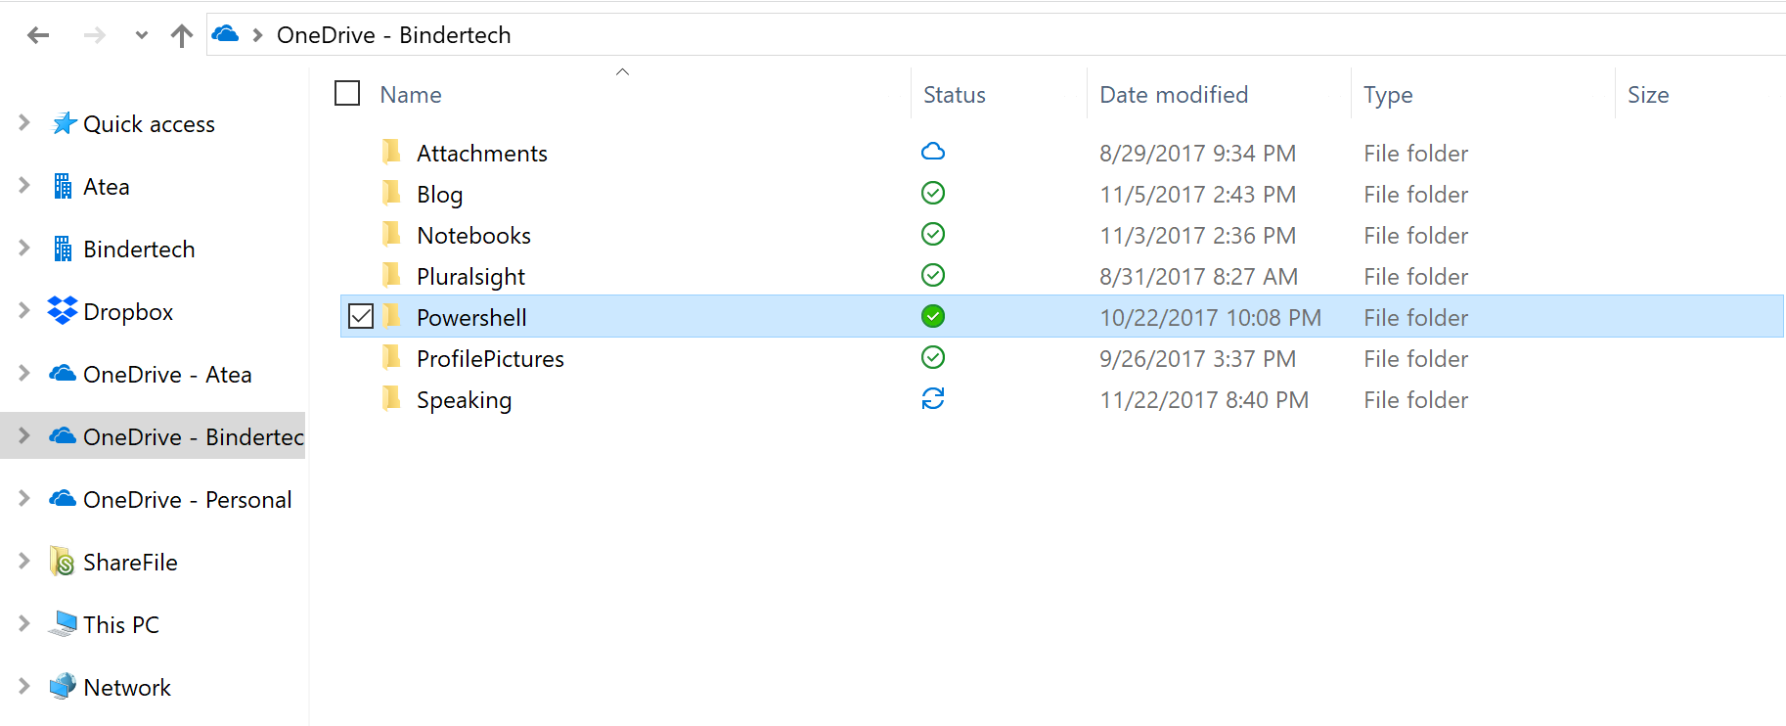
Notes:
https://support.office.com/en-us/article/Use-Group-Policy-to-control-OneDrive-sync-client-settings-0ecb2cf5-8882-42b3-a6e9-be6bda30899c#silentconfig
https://docs.microsoft.com/en-us/azure/active-directory/active-directory-saas-sharefile-tutorial

Slide 8
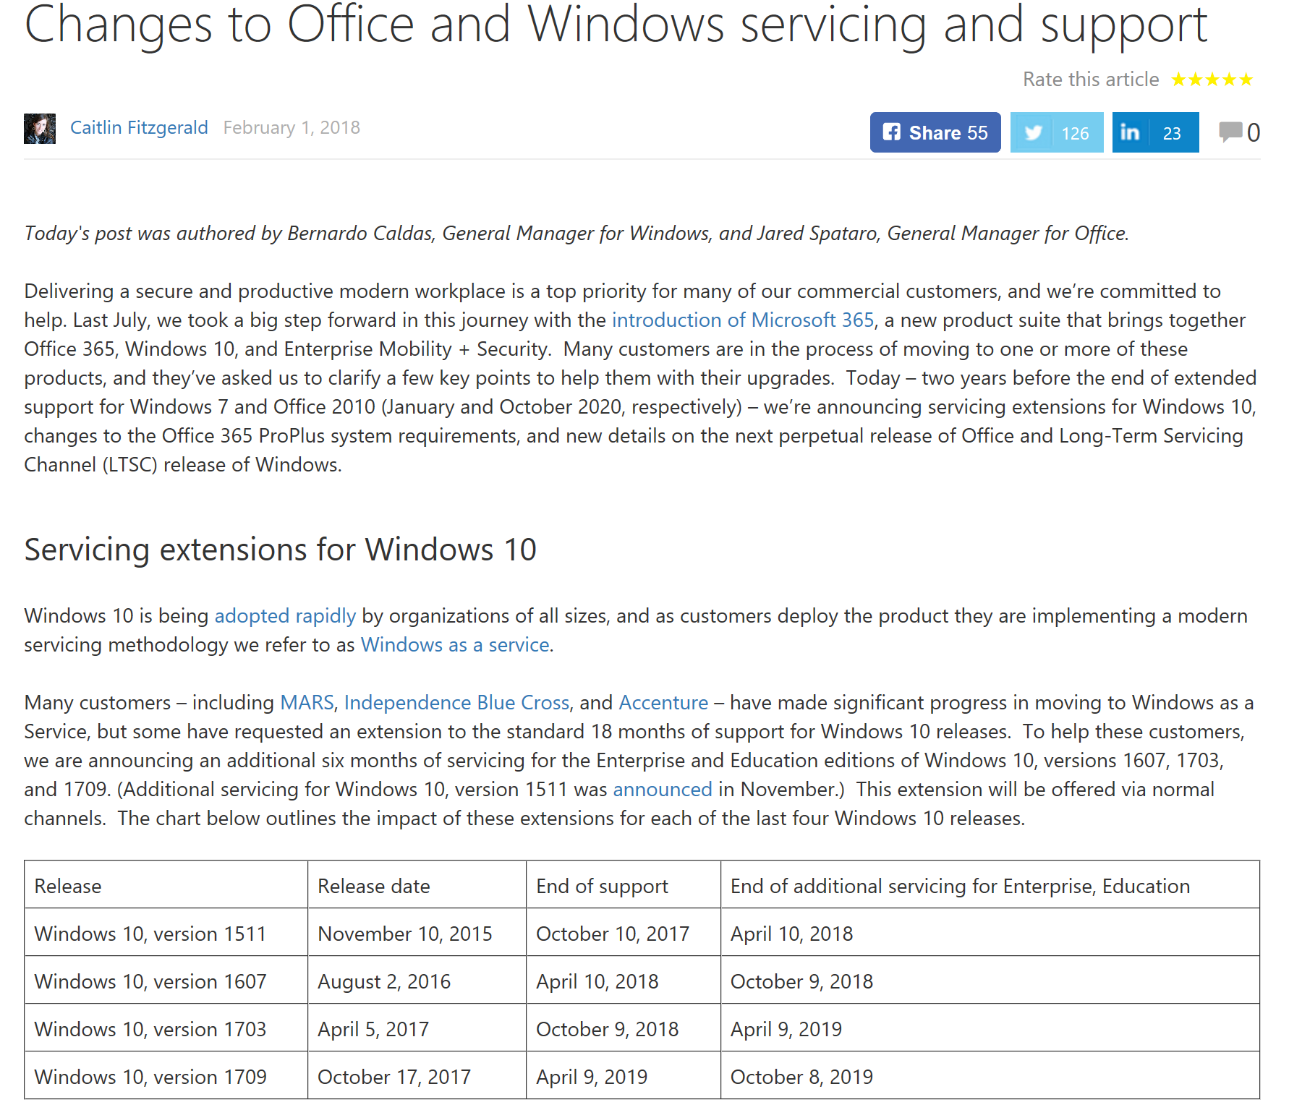
Notes:
Blogpost!!!
Office especially
I’ll mention Office as well:
ProPlus will only be supported on SAC versions that are being serviced.
From January 14 2020 – ProPlus will not be supported on LTSC, Windows Server 2016 and Windows 8.1 and older.
New virtualization options will be offered…
Office 2019 – H2 2018 (previews Q3 2018) – supported on Windows 10 SAC, W10 LTSC 2018, next LTSC of Windows Server. ONLY C2R!!! 5+2 years support (end 10/14 2025 – allinged with Office 2016)

Slide 9


Slide 10


Slide 11


Slide 12
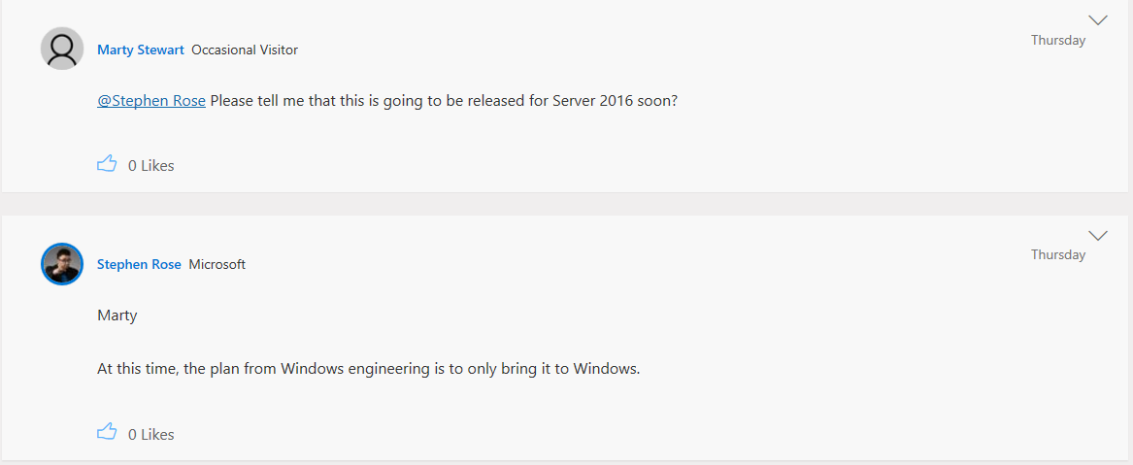
Notes:
https://techcommunity.microsoft.com/t5/OneDrive-Blog/OneDrive-Files-On-Demand-For-The-Enterprise/ba-p/117234

Slide 13
Demo

Slide 14
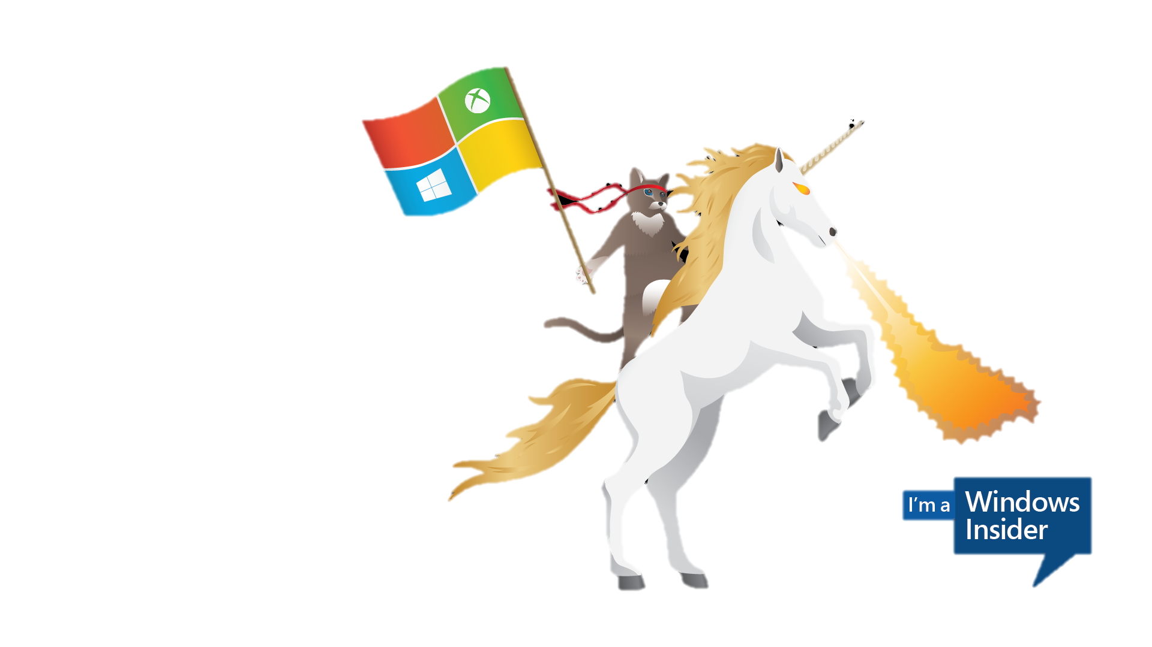

Slide 15
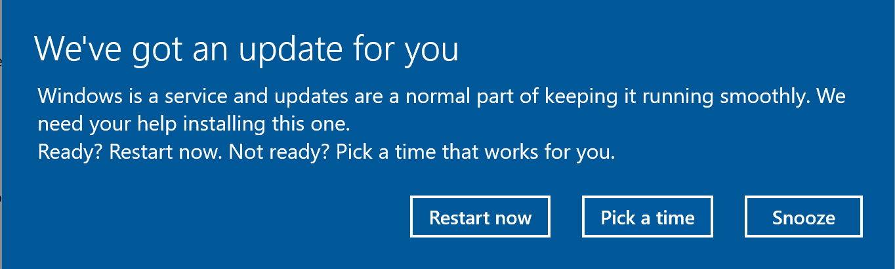

Slide 16
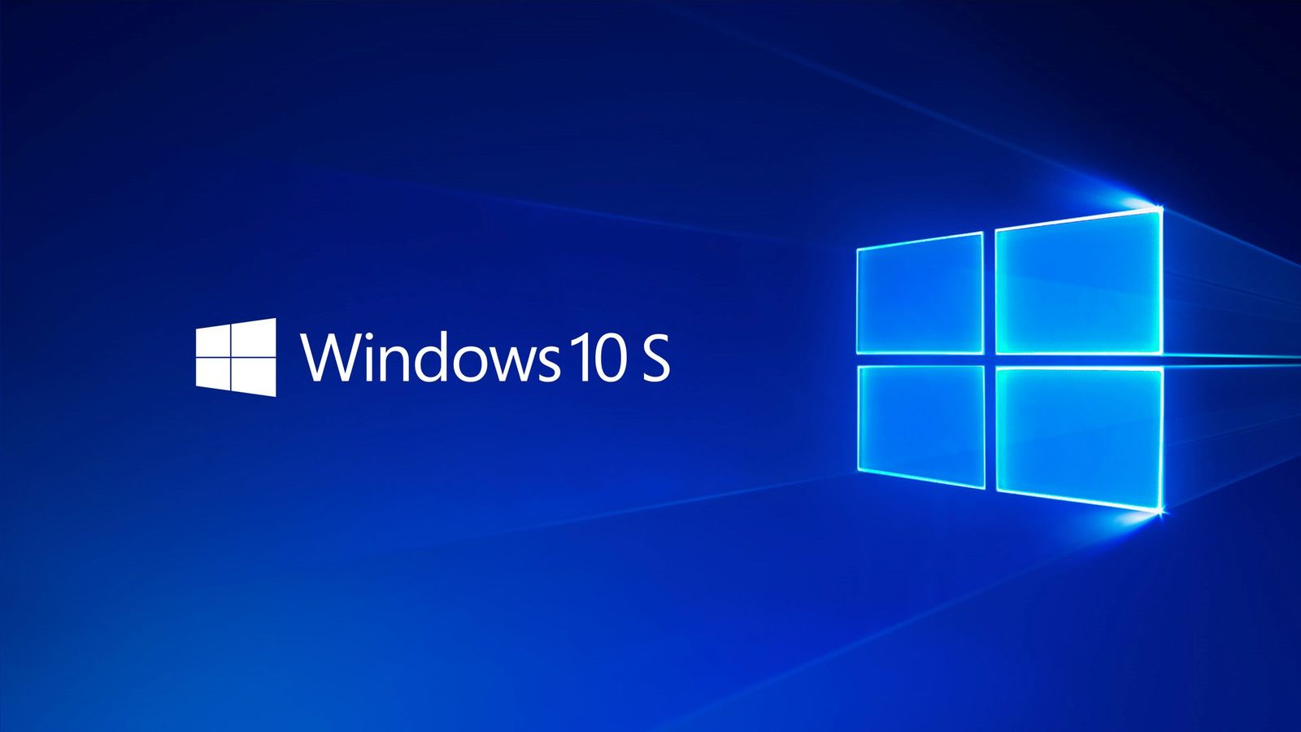
Notes:
https://stealthpuppy.com/deploy-citrix-receiver-intune/#.WmO7QkxFzB8

Slide 17
Demo

Slide 18
UWP
PWA
*

Slide 19
We need to have a revolution //Chris Jackson - @appcompatguy

Slide 20
Questions?
Notes:
The role Citrix has to fill – is at its core. Deliver apps and desktops where needed. Leverage it to enable WaaS – but you still have to manage your VDI:s and/or desktops. Which in itself isn’t easy – but essential.
You can of course leverage NetScaler in Azure, Sharefile, SD-WAN and all the other great products and solutions – but personally (as a Windows guy) I see the highest value in Citrix core business – and it will in return drive additional solutions.

Slide 21


Notes:
Either go from the Microsoft-side and up or the opposite
Its essential to work together, it has always been – but previously we have had some challenges. What’s the best way to deliver a desktop? How do we optimize it to do what its supposed to = serve the user. Today, we have reached a point in time where you have to be open minded about technology, especially IT. WE need to adopt new ways to collaborate and learn from each other. WE need to help our organizations & customers to deploy the right solution for each and every user. WE need to both remember what we know, cause its still valuable, but also embrace the future. WE don’t need to have a revolution – we need to start one!

Slide 22

Remember! Don’t drink and elevate!

Slide 23




Thank you!
simon.binder@bindertech.se
@Bindertech
Bindertech.se
Knee-Deep in Tech

Slide 24
Resources
Slides and demos from the conference will be available at github.com/nordicinfrastructureconference/2018 (bit.ly/2y7JhA3)

